Slide 1
Supercharge SAST
Semgrep Strategies for Secure Software

Slide 2
Agenda
SAST and AppSec
Getting started with Semgrep
Writing custom rules
Advanced Semgrep features
Practical exercises
Wrap-up
Q&A

Slide 3
About Us
Software Security Engineering
@ Microsoft
Arjun
https://www.linkedin.com/in/247arjun
Marcelo
https://www.linkedin.com/in/mribeirobr
Gautam
https://www.linkedin.com/in/perigautam

Slide 4
SAST and Application Security
MODULE 1

Slide 5
SAST and Application Security
Understanding SAST: Concepts and significance in securing software.
The role of SAST in the Software Development Life Cycle (SDLC).
Notes:
Marcelo

Slide 6
What is SAST?
Static Application Security Testing (SAST) is a testing methodology that analyzes source code to find security vulnerabilities in applications
Depends on patterns to define a vulnerability, also known as signatures
SAST can be used in real-time, as the developers code, it can be integrated into the DevOps cycle, or it can be executed offline.
As it is heavily dependent on signatures, it could lead to false positives if the signature base are not verified and tested to reduce de false alerts rate.
LLMs can also be leveraged to reduce the false positive/negative rates
Notes:
Understanding SAST and Its Role in SDL and DevOps
What is SAST?
Static Application Security Testing (SAST) is a method of security testing that analyzes source code or compiled versions of code to identify potential security vulnerabilities. Unlike dynamic testing, which examines a running application, SAST inspects the codebase itself without executing the program. This allows developers to detect and remediate vulnerabilities early in the development process. Key characteristics of SAST include:
- Early Detection: SAST can identify vulnerabilities during the development phase, well before the code is deployed.
Comprehensive Analysis: By examining the entire codebase, SAST can uncover a wide range of security issues, including those that might be missed during later stages of testing.
- Automated Scanning: SAST tools can automatically scan codebases, providing consistent and repeatable results.
The Positive Impact of SAST on SDL
The Secure Development Lifecycle (SDL) is a process that incorporates security at every stage of software development, from design to deployment. Integrating SAST into the SDL brings several benefits:
Early Vulnerability Detection: By identifying security flaws early, SAST reduces the cost and effort required to fix them. This leads to more secure code being produced from the start.
Improved Code Quality: Regular SAST scans encourage developers to follow secure coding practices, enhancing overall code quality.
Compliance and Risk Management: SAST helps ensure that code complies with security standards and regulations, reducing the risk of security breaches and associated legal or financial penalties.
Continuous Improvement: By integrating SAST into the development process, teams can continuously monitor and improve their security posture, adapting to new threats and vulnerabilities as they arise.
Integrating SAST into SDL/DevOps Pipelines
To maximize the benefits of SAST, it is essential to integrate it seamlessly into your SDL and DevOps pipelines. Here’s how you can do it:
Automate SAST Scans: Incorporate SAST tools into your continuous integration (CI) pipeline. Automated scans can be triggered with each code commit or at regular intervals, ensuring that new code is continuously tested for vulnerabilities.
Shift Left: Implement SAST early in the development process. Developers should run SAST scans on their local environments before committing code. This practice, known as "shifting left," helps catch vulnerabilities as soon as they are introduced.
Integrate with CI/CD Tools: Use CI/CD tools like Jenkins, GitLab CI, or Azure DevOps to integrate SAST tools. These tools can automatically run SAST scans as part of the build process, providing immediate feedback to developers.
Set Up Alerts and Dashboards: Configure alerts and dashboards to monitor SAST scan results. This ensures that developers and security teams are promptly notified of any vulnerabilities, allowing for quick remediation.
Enforce Quality Gates: Define quality gates that must be passed before code can be merged or deployed. For instance, code with high-severity vulnerabilities should be blocked from progressing further in the pipeline until the issues are resolved.
Continuous Training and Awareness: Ensure that developers are trained on the importance of SAST and how to interpret and act on its findings. Regular training sessions and security awareness programs can reinforce the importance of secure coding practices.
Regular Review and Update: Periodically review and update SAST tools and configurations to adapt to new security threats and vulnerabilities. Keeping your SAST tools and rulesets current ensures that they remain effective in identifying the latest security risks.

Slide 7
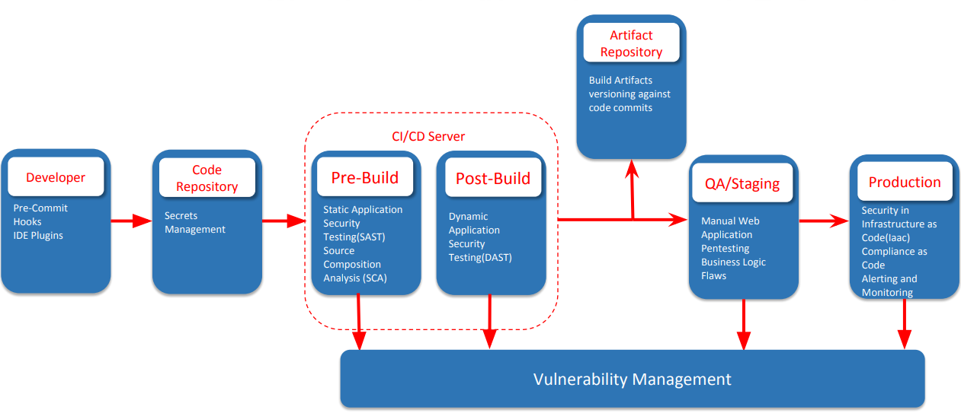
Typical SDLC
Notes:
1. Developer
Developers write code and make changes to the software application. They use integrated development environments (IDEs) and version control systems to manage their code.
2. Code Repository
The code repository is a centralized version control system (e.g., Git) where developers push their code changes. It serves as the single source of truth for the codebase, enabling collaboration and version tracking.
3. Continuous Integration (CI) Server
The CI server (e.g., Jenkins, GitLab CI, Travis CI) automates the process of integrating code changes from multiple developers. When code is committed to the repository, the CI server automatically triggers builds and runs a series of tests to ensure that the code integrates smoothly with the existing codebase.
4. Artifact Repository
The artifact repository (e.g., JFrog Artifactory, Nexus) stores built artifacts (e.g., binaries, libraries, container images) that are produced during the CI process. These artifacts are versioned and can be deployed to various environments, ensuring consistency across deployments.
5. Quality Assurance (QA)
The QA environment is where comprehensive testing is performed, including automated tests (e.g., unit tests, integration tests, end-to-end tests) and manual testing. This stage ensures that the software meets quality standards before it is deployed to production.
6. Production
The production environment is where the final version of the software is deployed for end-users. This environment is configured to handle real-world usage, ensuring high availability, performance, and security.
7. Vulnerability Management
Vulnerability management is integrated throughout the pipeline to identify, assess, and remediate security vulnerabilities. Here’s how it fits into each stage:
During Development: Developers use Static Application Security Testing (SAST) tools to scan their code for vulnerabilities before committing it to the repository. This ensures that security issues are caught early.
In the CI Server: The CI server includes security tests as part of the build process. Dynamic Application Security Testing (DAST) tools can be used to scan running applications for vulnerabilities. Security gates can be enforced to block deployments if critical vulnerabilities are found.
Artifact Repository: Artifacts are scanned for known vulnerabilities (e.g., using tools like Nexus IQ or JFrog Xray) before they are stored. This ensures that only secure artifacts are promoted to the next stages.
QA: Security testing is part of the QA process. Penetration testing, vulnerability scanning, and other security assessments are conducted to identify potential issues.
Production: Continuous monitoring tools (e.g., Intrusion Detection Systems, Web Application Firewalls) are used to detect and respond to security threats in real time. Regular vulnerability assessments and patch management practices are maintained to keep the production environment secure.

Slide 8
Getting Started with Semgrep
MODULE 2

Slide 9
Getting Started with Semgrep
Installing and configuring Semgrep.
Navigating the Semgrep ecosystem: CLI and Playground.
Notes:
Marcelo

Slide 10
Installing and getting ready
Install Semgrep on Linux, Windows and macOS
Pre-Requisite: Having Python 3.8 pre-installed
With all those OS, we can install Semgrep with PIP (make sure you have PIP installed)
python3 –m pip install semgrep
Installing Semgrep using other methods (Homebrew on macOS) or use the Semgrep Docker container to run it are options, but those methods won’t be covered on this workshop.
Notes:
Windows
Using pip (recommended):
Ensure Python and pip are installed on your system.
Open Command Prompt and run:
pip install semgrep
Using Docker:
Ensure Docker is installed and running on your system.
Open Command Prompt and pull the Semgrep Docker image:
docker pull returntocorp/semgrep
Run Semgrep with Docker:
docker run --rm -v %cd%:/src returntocorp/semgrep semgrep --config auto /src
Linux
Using pip (recommended):
Ensure Python and pip are installed. On Debian-based systems, you can install them using:
sudo apt update
sudo apt install python3 python3-pip
Install Semgrep using pip:
pip3 install semgrep
Using Docker:
Ensure Docker is installed and running.
Open Terminal and pull the Semgrep Docker image:
docker pull returntocorp/semgrep
Run Semgrep with Docker:
docker run --rm -v $(pwd):/src returntocorp/semgrep semgrep --config auto /src
Using apt (Debian-based systems):
Add the Semgrep repository and install Semgrep:
echo "deb [trusted=yes] https://apt.returntocorp.com/ buster main" | sudo tee /etc/apt/sources.list.d/returntocorp.list
sudo apt update
sudo apt install semgrep
macOS
Using Homebrew (recommended):
Ensure Homebrew is installed.
Open Terminal and install Semgrep:
brew install semgrep
Using pip:
Ensure Python and pip are installed. You can install Python using Homebrew:
brew install python
Install Semgrep using pip:
pip3 install semgrep
Using Docker:
Ensure Docker is installed and running.
Open Terminal and pull the Semgrep Docker image:
docker pull returntocorp/semgrep
Run Semgrep with Docker:
docker run --rm -v $(pwd):/src returntocorp/semgrep semgrep --config auto /src

Slide 11
Semgrep… Installing and getting ready
Two use modes:
Online rules with Semgrep web interface (semgrep.dev)
The GUI helps with analysis over the findings
It has a free tier, but not for the PRO ruleset
Local rules
You can use the default ruleset, and add local rules set you built or downloaded
It generates text-formatted outputs with the findings
It does not provide a GUI to help with analysis… (but you can always feed the results into an ELK/Spluk for analysis…)
We will focus on features available on the Open Source ONLY!

Slide 12
Navigating the Semgrep ecosystem: CLI and Playground
Basic CLI Command:
semgrep scan [options] [targets]
Some interesting Semgrep CLI options:
--config auto – Downloads the relevant rules for the current project from Semgrep opensource rules repository
--config <path_to_rules> - Points to local custom rulesets
Output formats
--json – Output to JSON formatted file
--text – Output to a text formatted file
--vim – Output to a vim-friendly formatted file
--sarif – Output to a sarif formatted file
Notes:
Most Used Semgrep CLI Options
--config
Specifies the configuration file or directory containing Semgrep rules.
Example: semgrep --config path/to/rules/ /path/to/code
--output
Specifies the file to which the results should be written.
Example:
semgrep --config path/to/rules/ /path/to/code --output results.json
--exclude
Excludes files or directories from being scanned.
Example:
semgrep --config path/to/rules/ /path/to/code --exclude path/to/exclude/
--include
Only includes specified files or directories for scanning.
Example:
semgrep --config path/to/rules/ /path/to/code --include path/to/include/
--timeout
Sets the maximum time (in seconds) for each rule to run.
Example:
semgrep --config path/to/rules/ /path/to/code --timeout 30
--metrics
Enables or disables metrics reporting.
Example:
semgrep --config path/to/rules/ /path/to/code --metrics off
--no-git-ignore
Ignores the .gitignore file and scans all files.
Example:
semgrep --config path/to/rules/ /path/to/code --no-git-ignore
--severity
Filters findings by severity level (INFO, WARNING, ERROR).
Example:
semgrep --config path/to/rules/ /path/to/code --severity ERROR
--error
Treats findings as errors and exits with a non-zero status code.
Example:
semgrep --config path/to/rules/ /path/to/code --error
--test
Validates the rules without running them on the target code.
Example:
semgrep --config path/to/rules/ --test
--quiet
Suppresses output, only showing errors.
Example:
semgrep --config path/to/rules/ /path/to/code --quiet
--json
Outputs results in JSON format.
Example:
semgrep --config path/to/rules/ /path/to/code --json
--sarif
Outputs results in SARIF format (Static Analysis Results Interchange Format).
Example:
semgrep --config path/to/rules/ /path/to/code --sarif
--strict
Exits with an error if any rule fails to run.
Example:
semgrep --config path/to/rules/ /path/to/code --strict
--baseline-include
Compares the results against a baseline and only reports new findings.
Example:
semgrep --config path/to/rules/ /path/to/code --baseline-include baseline.json
Example Usage
Combining multiple options in a Semgrep command:
semgrep --config path/to/rules/ --include src/ --exclude tests/ --output results.json --json --timeout 30 /path/to/code
This command will:
Use the rules in path/to/rules/.
Scan only the src/ directory, excluding the tests/ directory.
Output the results in JSON format to results.json.
Set a timeout of 30 seconds per rule.
These options provide flexibility and control over how Semgrep scans and reports on your codebase using local signatures.

Slide 13
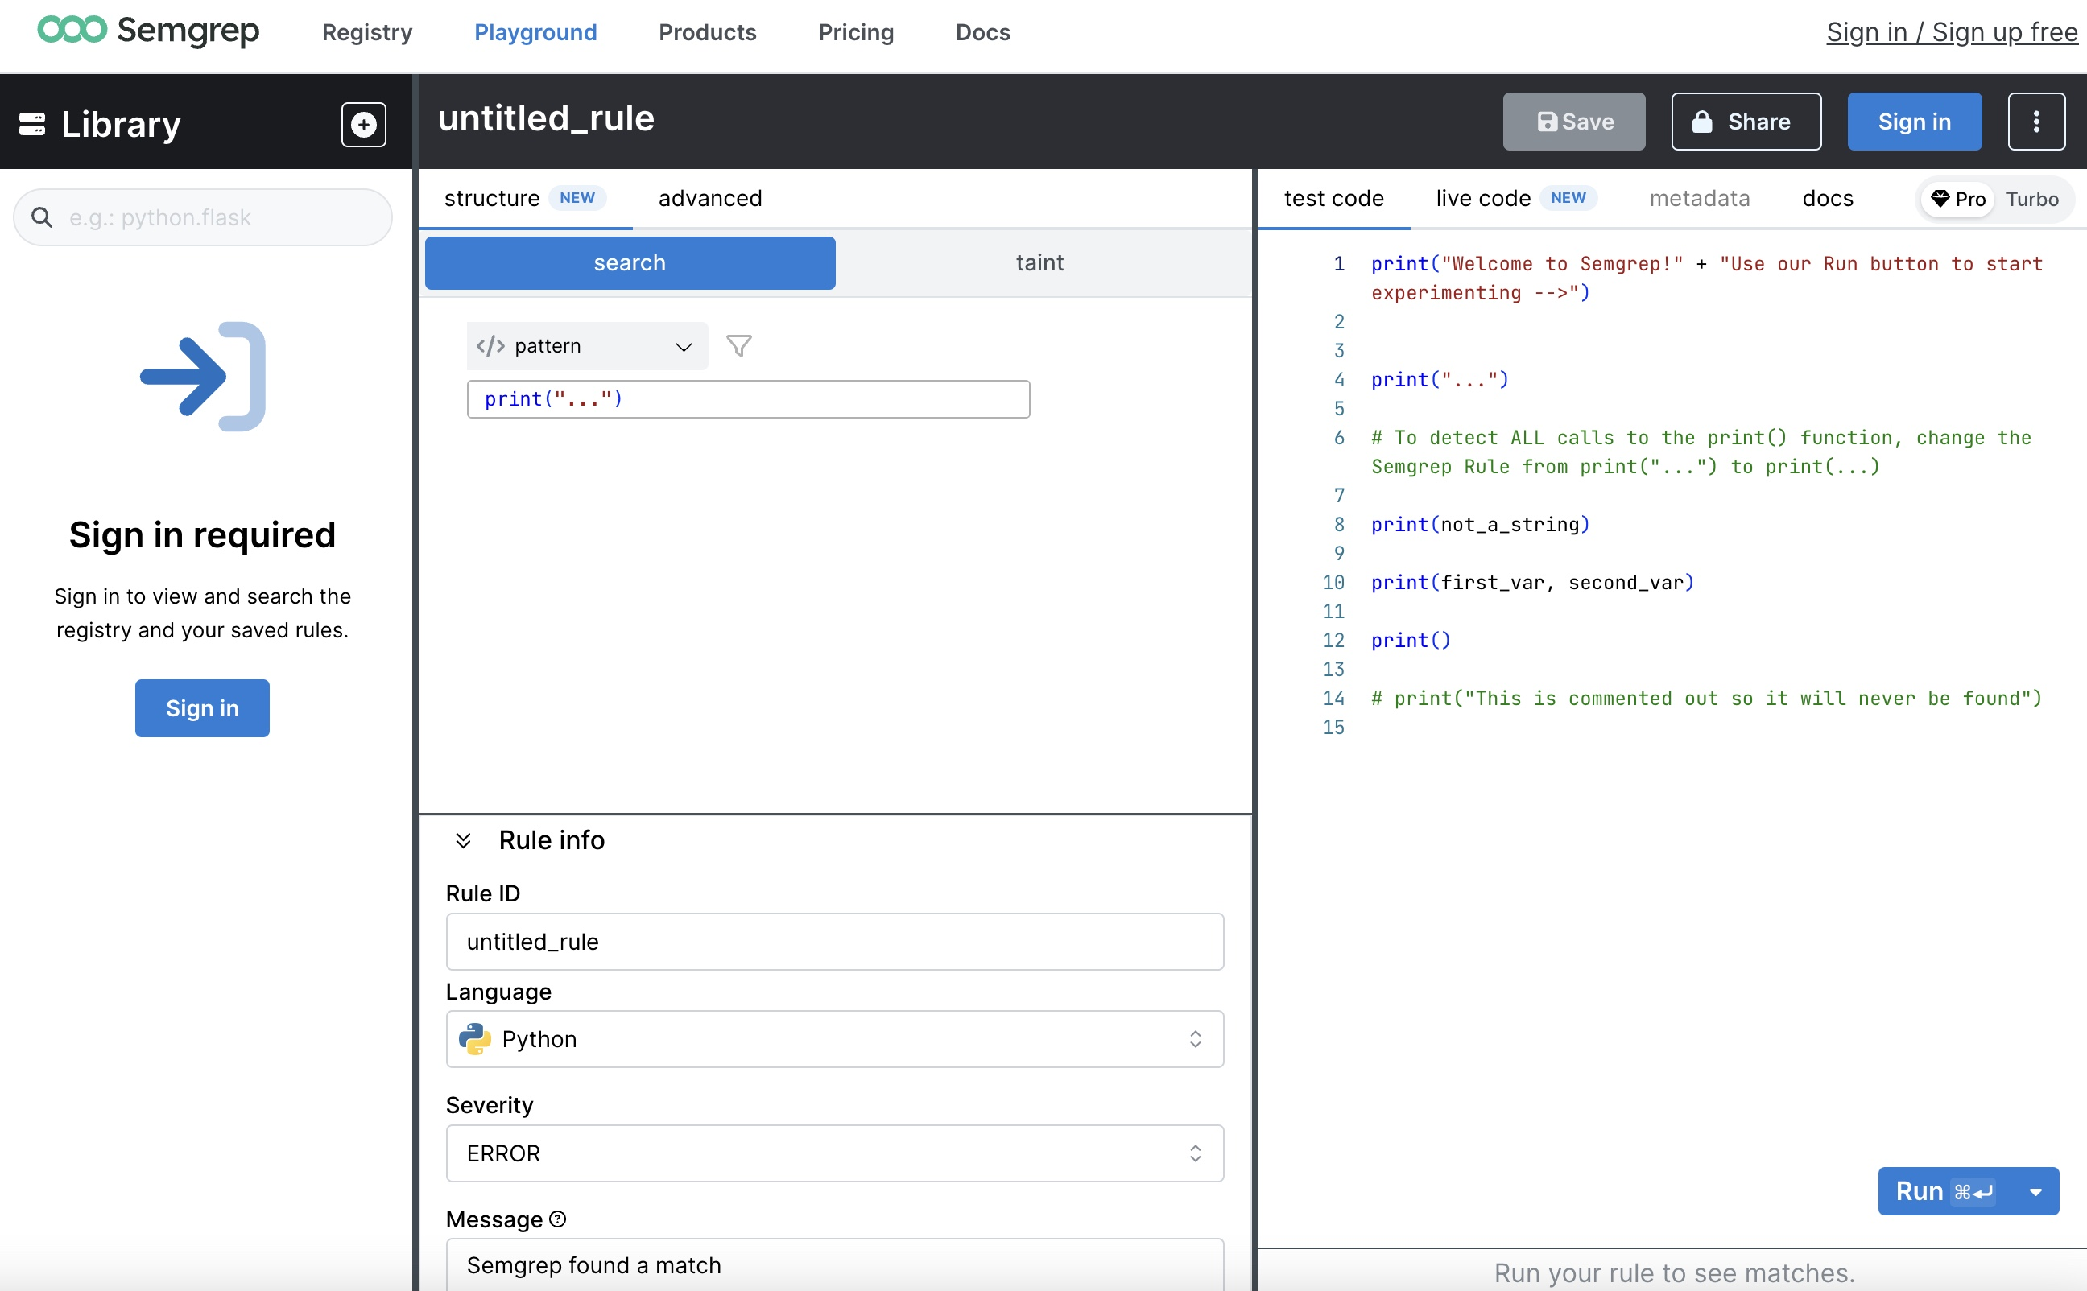
Semgrep Playground (https://semgrep.dev/playground/new)

Slide 14
Writing Custom Semgrep Rules
MODULE 3

Slide 15
Writing Custom Semgrep Rules
Deep dive into Semgrep’s rule syntax and pattern matching.

Slide 16
Semgrep Rules
A rule is a specification of the patterns that Semgrep must match to the code to generate a finding.
Semgrep Rules are written in YAML
Semgrep supports multiple languages
e.g.: Python, Java, C#, JavaScript, Go, etc..
Multiple modes
Search (default)
Taint
Join
Extract
Notes:
A rule is a specification of the patterns that Semgrep must match to the code to generate a finding.
These rules are written in YAML
Semgrep supports wide range of languages such as Python, C#, JavaScript, Go so on
Semgrep also has multiple modes
Search is the default mode. Taint mode runs taint analysis, Join mode is an experimental feature and Extract mode is deprecated.

Slide 17
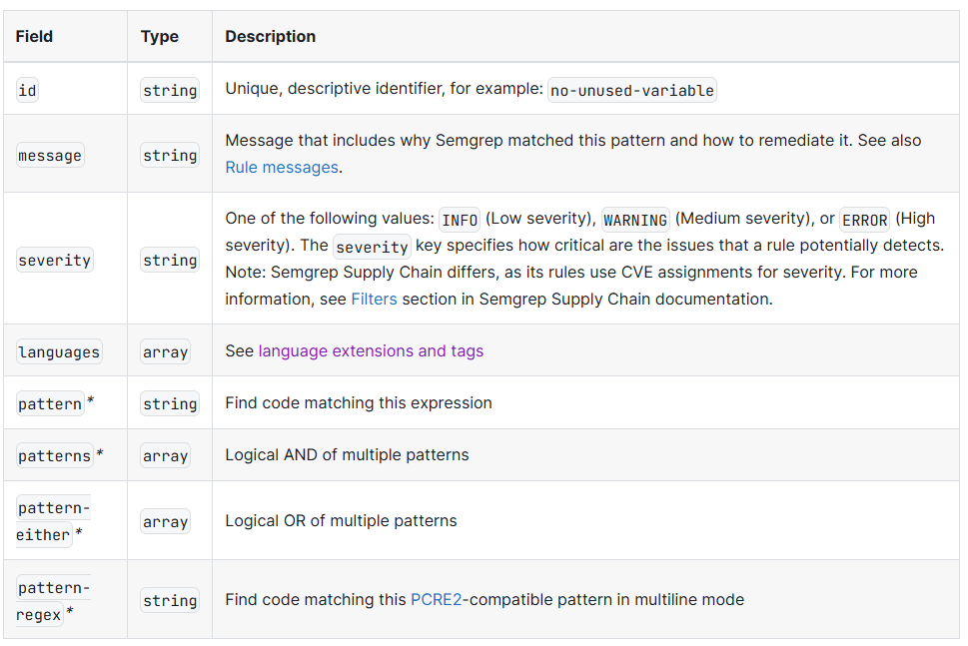
Schema – Required Fields
Rule syntax | Semgrep
Notes:
The table shows the required fields in a Semgrep rule. For a given rule
id, message, severity, language and one of the patterns are required fields

Slide 18
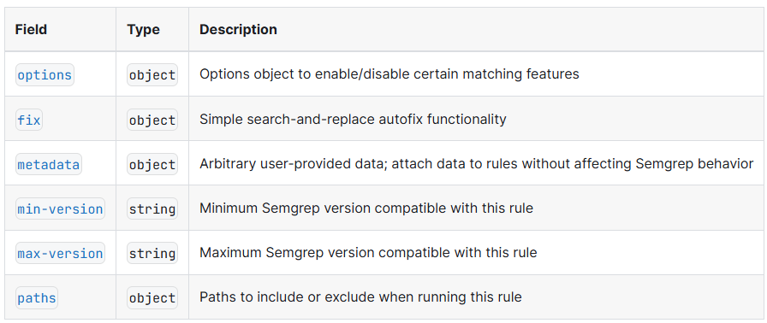
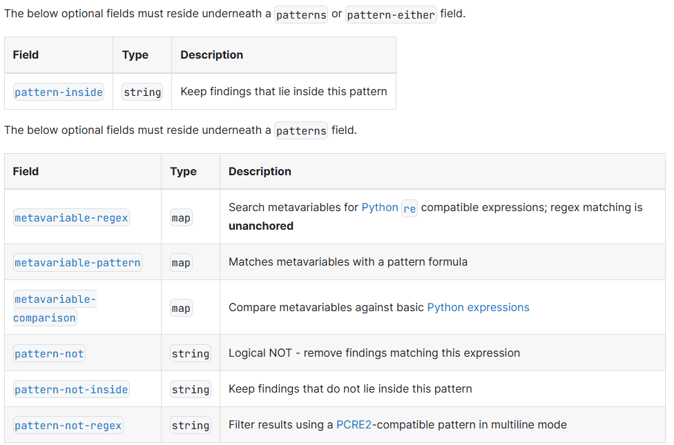
Schema – Optional Fields
Rule syntax | Semgrep
Notes:
A rule can also have some optional fields such as options, metadata, fields for versioning.
Some optional fields in patterns

Slide 19
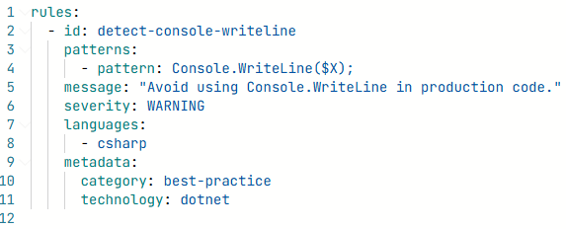
Semgrep Rule Syntax
Required fields
Optional fields
Rule syntax | Semgrep
Notes:
Here is a simple Semgrep rule that shows the required fields and optional fields

Slide 20
Pattern Syntax
Ellipsis Operator (…)
Metavariables ($VARNAME)
Rule syntax | Semgrep
Notes:
Pattern Syntax in Semgrep.
There are two important operators in Semgrep. Ellipsis & Metavariables
Ellipsis & Metavariables are used to abstract away some chunks of code. These are two important operators to write an effective Semgrep rule

Slide 21
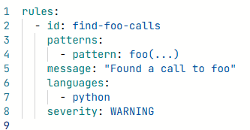
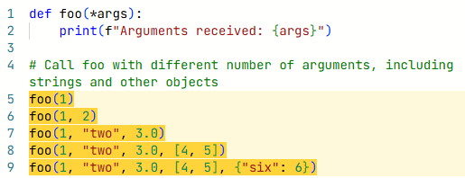
Ellipsis Operator …
Abstracts away a sequence of zero or more items such as arguments, statements, parameters, fields, characters.
Matches
Rule syntax | Semgrep
Notes:
The ... ellipsis operator abstracts away a sequence of zero or more items such as arguments, statements, parameters, fields, characters.
The ... ellipsis can also match any single item that is not part of a sequence when the context allows it.
Exercise: https://github.com/django/django/blob/main/django/urls/base.py

Slide 22
Ellipsis Operator …
Exercise - (aka.ms/semgrep-exercises)
https://github.com/django/django/blob/main/django/http/request.py
Flag and return the entire function body for
def get_host(self):
def _get_full_path( ): – not knowing the function’s arguments
Rule syntax | Semgrep

Slide 23
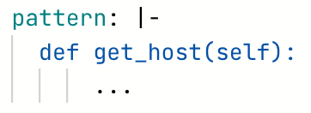
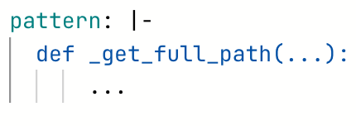
Ellipsis Operator …
Answers
Flag and return the entire function body for
def get_host(self):
def _get_full_path – not knowing the function’s arguments
Rule syntax | Semgrep

Slide 24
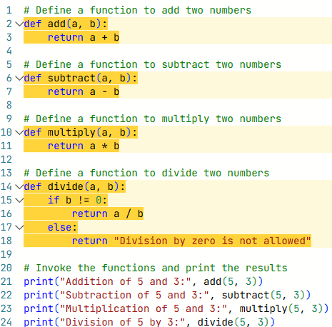
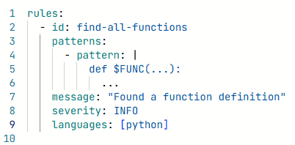
Metavariables - $VARIABLE_NAME
Metavariables are an abstraction to match code when you don’t know the value or contents ahead of time
Rule syntax | Semgrep
Notes:
Metavariables are an abstraction to match code when you don’t know the value or contents ahead of time
They begin with a $ and can only contain uppercase characters, _, or digits.

Slide 25
Metavariables - $VARIABLE_NAME
Exercise - (aka.ms/semgrep-exercises)
https://github.com/django/django/blob/main/django/http/request.py
Flag and return the entire function bodies that contain the line
return self.scheme == “https”
parser = MultiPartParser(…)
Rule syntax | Semgrep

Slide 26
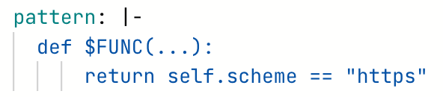
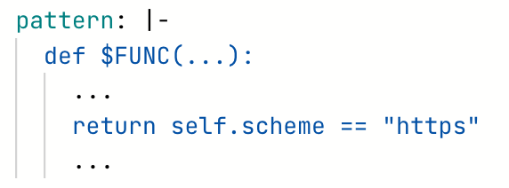
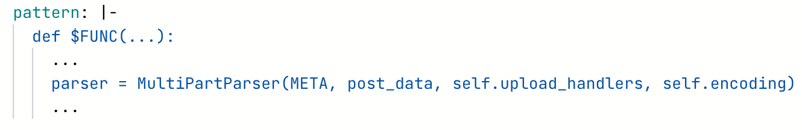
Metavariables - $VARIABLE_NAME
Answers
Flag and return the entire function bodies that contain the line
return self.scheme == “https”
parser = MultiPartParser(META, post_data, self.upload_handlers, self.encoding)
Rule syntax | Semgrep

Slide 27
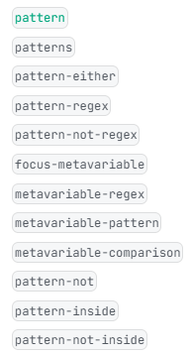
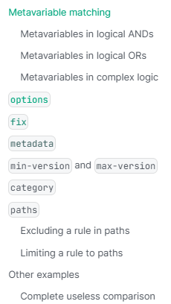
Pattern Matching Operators
Rule syntax | Semgrep
Notes:
Semgrep has a bunch of pattern matching operators we’ll cover a few of them

Slide 28
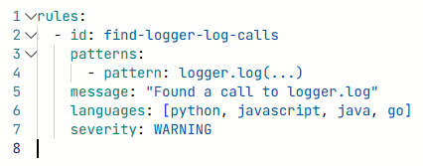
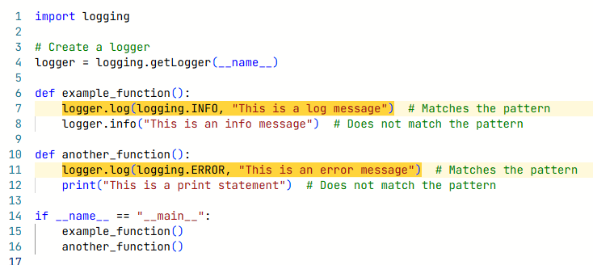
Pattern
The pattern operator looks for code matching its expression.
Rule syntax | Semgrep
Notes:
The pattern operator looks for code matching its expression.

Slide 29
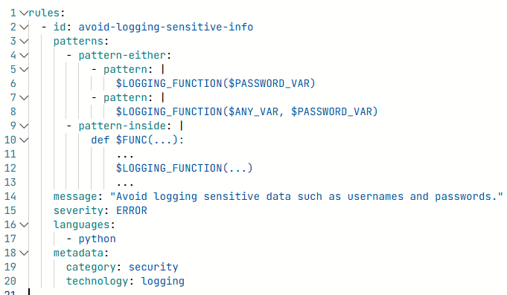
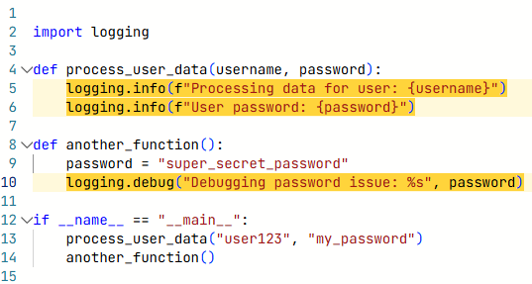
Patterns
Performs a logical AND operation on one or more child patterns.
Chaining multiple patterns together
Rule syntax | Semgrep
Notes:
The patterns operator performs a logical AND operation on one or more child patterns. This is useful for chaining multiple patterns together that all must be true.

Slide 30
Patterns
Exercise - (aka.ms/semgrep-exercises)
https://github.com/django/django/blob/main/django/http/request.py
Using 1 rule, flag and return the line of code
That is inside a function named read
And sets the _read_started attribute to True
Rule syntax | Semgrep

Slide 31
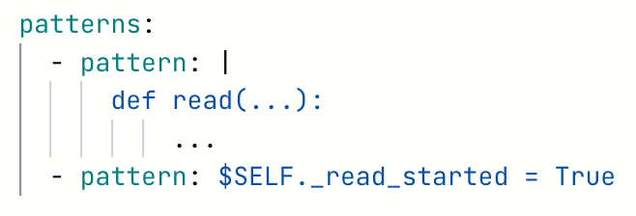
Patterns
Answer
Using 1 rule, flag and return the line of code
That is inside a function named read
And sets the _read_started attribute to True
Rule syntax | Semgrep

Slide 32
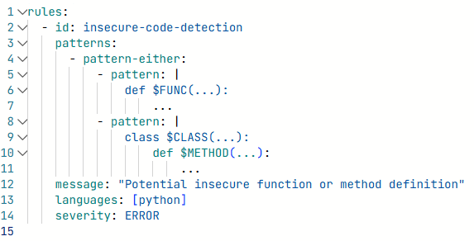
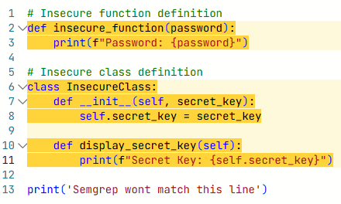
Pattern-Either
Performs a logical OR operation on one or more child patterns.
Chaining multiple patterns together
Rule syntax | Semgrep
Notes:
The pattern-either operator performs a logical OR operation on one or more child patterns. This is useful for chaining multiple patterns together where any may be true.

Slide 33
Pattern-Either
Exercise - (aka.ms/semgrep-exercises)
https://github.com/django/django/blob/main/django/http/request.py
Using 1 rule, flag and return both functions
A function named read
A function named readline
Rule syntax | Semgrep

Slide 34
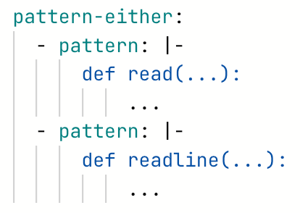
Pattern-Either
Answer
Using 1 rule, flag and return both functions
A function named read
A function named readline
Rule syntax | Semgrep

Slide 35
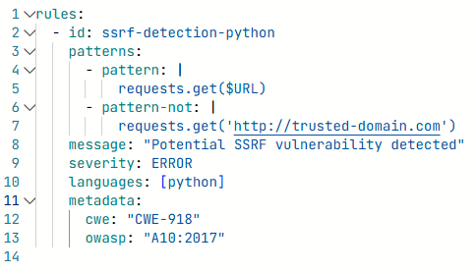
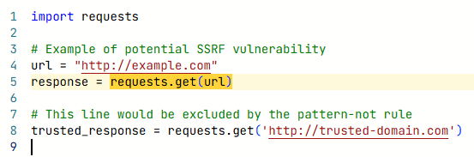
Pattern-Not
The pattern-not operator is the opposite of the pattern operator.
Finds code that does NOT match its expression
Rule syntax | Semgrep
Notes:
The pattern-not operator is the opposite of the pattern operator. It finds code that does not match its expression

Slide 36
Pattern-Not
Exercise - (aka.ms/semgrep-exercises)
https://github.com/django/django/blob/main/django/http/request.py
Using 1 rule, flag and return both functions
All functions named encoding
But not those that are one-liners
return self._encoding
self._encoding = value
Rule syntax | Semgrep

Slide 37
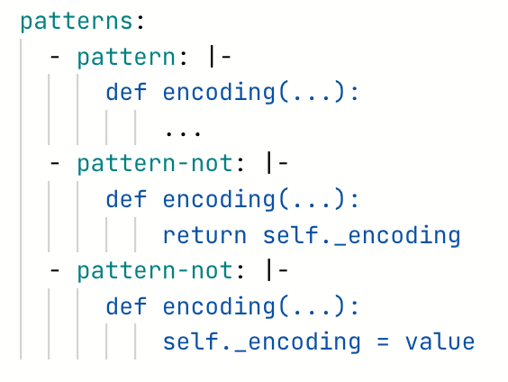
Pattern-Not
Answer
Using 1 rule, flag and return both functions
All functions named encoding
But not those that are one-liners
return self._encoding
self._encoding = value
Rule syntax | Semgrep

Slide 38
Pattern-Inside
Matches findings that reside within its expression
Rule syntax | Semgrep
Notes:
The pattern-inside operator keeps matched findings that reside within its expression

Slide 39
Pattern-Inside
Exercise - (aka.ms/semgrep-exercises)
https://github.com/django/django/blob/main/django/http/request.py
Using 1 rule, flag and return
All instances of if hasattr(...): ...
That are inside a function named encoding
Rule syntax | Semgrep

Slide 40
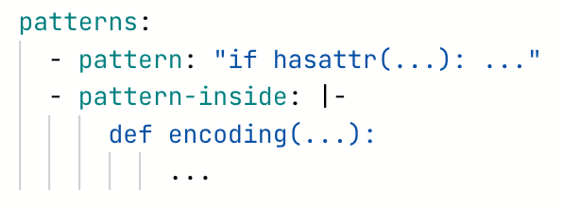
Pattern-Inside
Answer
Using 1 rule, flag and return
All instances of if hasattr(...): ...
That are inside a function named encoding
Rule syntax | Semgrep

Slide 41
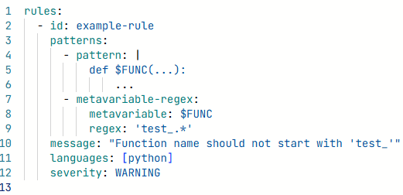
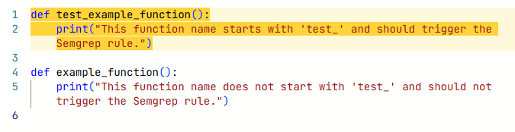
Metavariable regex
Searches metavariables for a PCRE2 regular expression
Useful in filtering results based on a metavariable’s value
Rule syntax | Semgrep
Notes:
The metavariable-regex operator searches metavariables for a PCRE2 (Perl compatible regular expression) regular expression. This is useful for filtering results based on a metavariable’s value. It requires the metavariable and regex keys and can be combined with other pattern operators.

Slide 42
Metavariable-regex
Exercise - (aka.ms/semgrep-exercises)
https://github.com/django/django/blob/main/django/http/request.py
Using 1 rule, flag and return
All function names that begin with get_full_path
Rule syntax | Semgrep

Slide 43
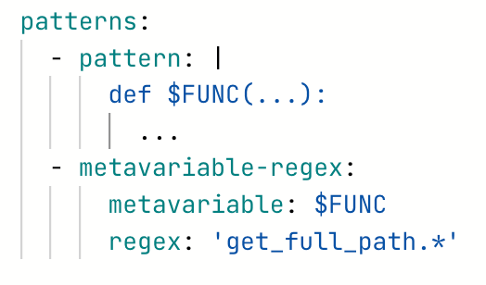
Metavariable-regex
Answer
Using 1 rule, flag and return all function names that begin with get_full_path
Rule syntax | Semgrep

Slide 44
Advanced Semgrep Features
MODULE 4

Slide 45
Advanced Semgrep Features
Overview of advanced Semgrep features: Taint mode, and editor integration.
Leveraging Semgrep findings for LLM-based code analysis.

Slide 46
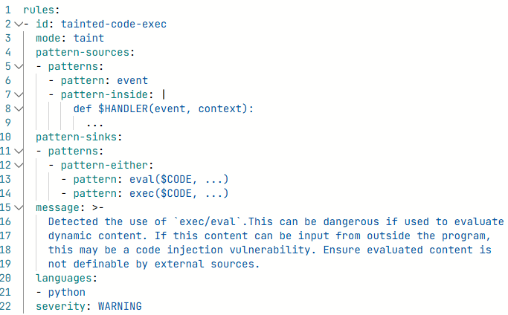
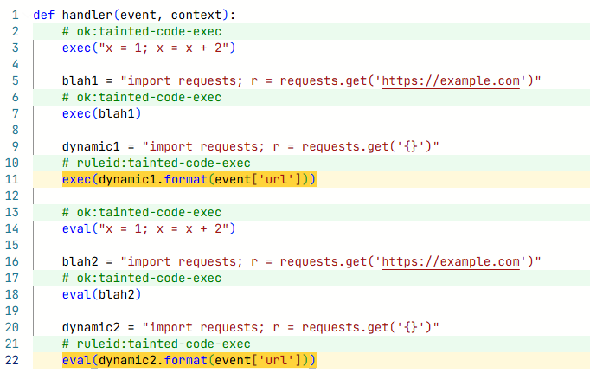
Taint Mode
Tracks the flow of untrusted, or tainted data throughout the body of a function or method
Taint Mode | Semgrep
Notes:
tracks the flow of untrusted, or tainted data throughout the body of a function or method. Tainted data originate from tainted sources. If tainted data is not transformed or checked accordingly (sanitized), taint analysis reports a finding whenever tainted data reach a vulnerable function, called a sink. Tainted data flow from sources to sinks through propagators, such as assignments, or function calls.

Slide 47
LLM-based Code Analysis
SAST triage can be painful
Scale
Context
Confidence
Leverage LLM capabilities
At scale
With context
Increased confidence

Slide 48
LLM-based Code Analysis
SAST results can be exported via SARIF
LLMs excel at (code) summarization
Some LLMs have a ”JSON constrained” output guarantee
LLMs exhibit understanding the JSON spec

Slide 49
Building it up
SARIF offers interoperability between SAST tools
SARIF is JSON
Lots of language support to parse JSON

Slide 50
Building it up
LLMs excel at summarization
LLMs are also good at code generation
LLMs need grounding and good prompts

Slide 51
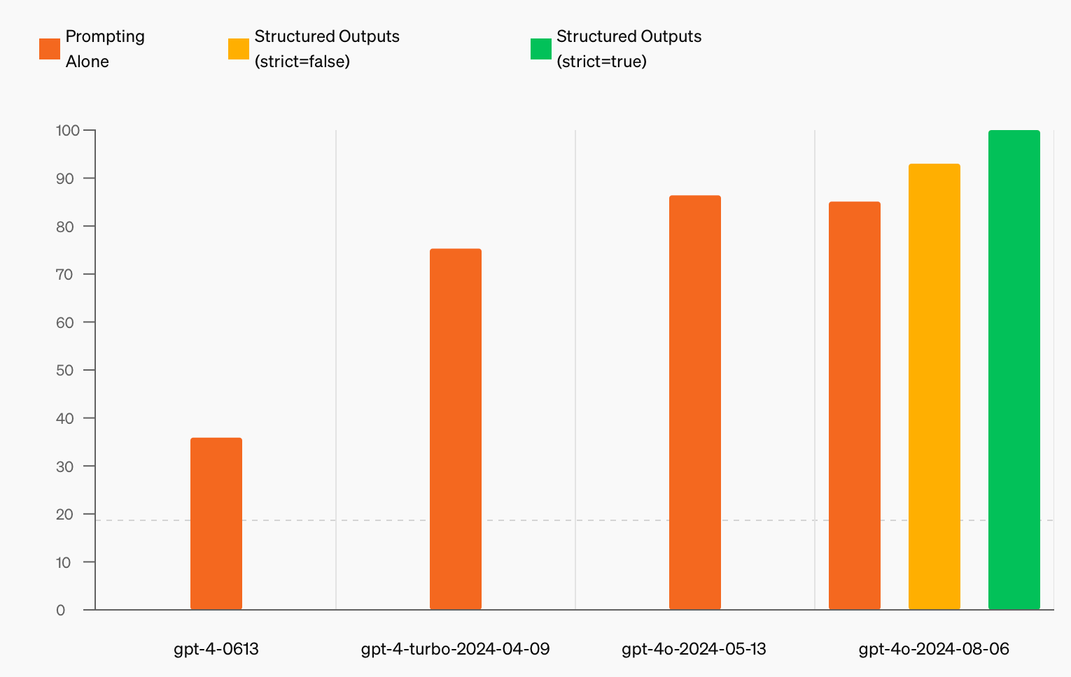
Building it up
LLMs love to talk
LLMs can also be constrained to respond in certain manner, but with minimal guarantee of compliance
Some LLMs have a “JSON constrained” output guarantee
Structured Output Mode

Slide 52
Building it up
LLMs exhibit understanding the JSON spec
Redux: JSON is great for parsing
Constraining output to JSON allows for structured summarization

Slide 53
Building it up
Prompting is part art/science
Persona + Scenario + Output constraint + Input to analyze
More “context” increases accuracy of LLM output
Custom rules to output full class body
Fetch file content from URL

Slide 54
Putting it together
Semgrep scan
Outputs SARIF
SARIF (JSON) Parse
Extract code snippet
Prompt GPT
System Prompt + JSON constraint on output + Code to analyze
GPT Response
JSON output

Slide 55
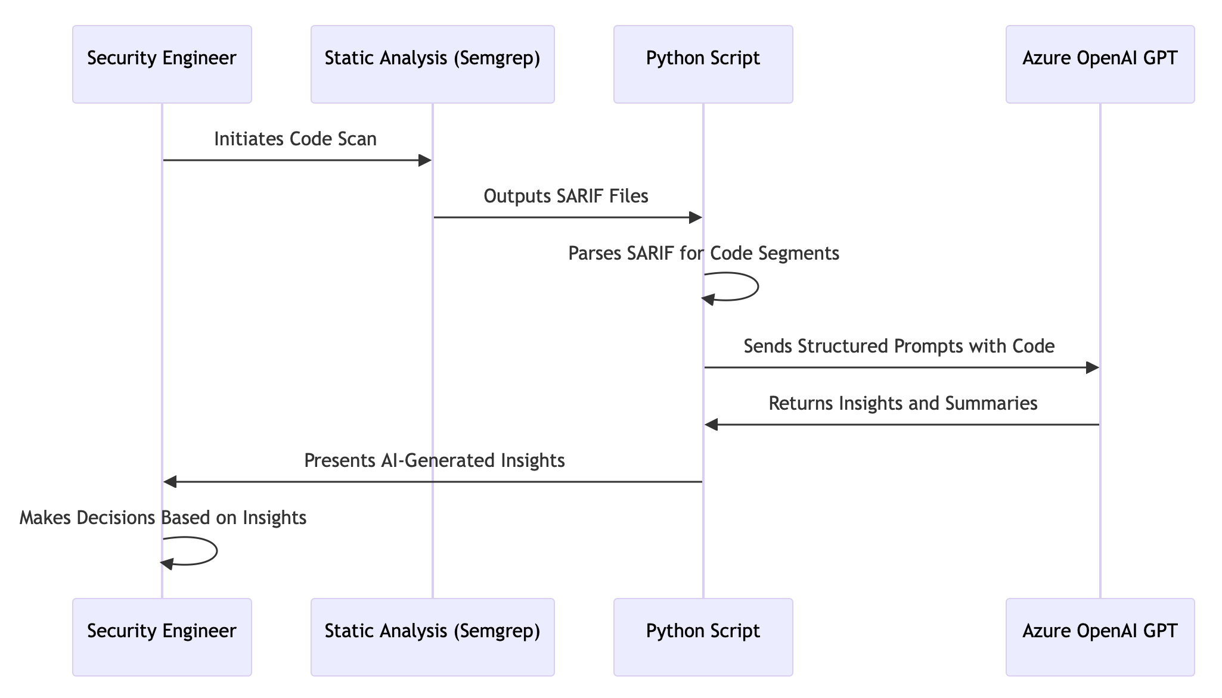
Putting it together

Slide 56
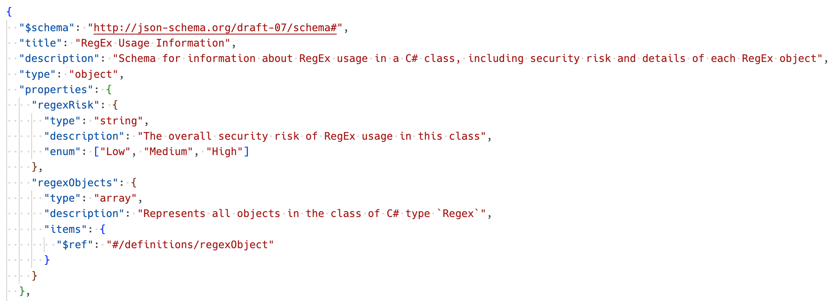
Putting it together
Prompt
Basic

Slide 57
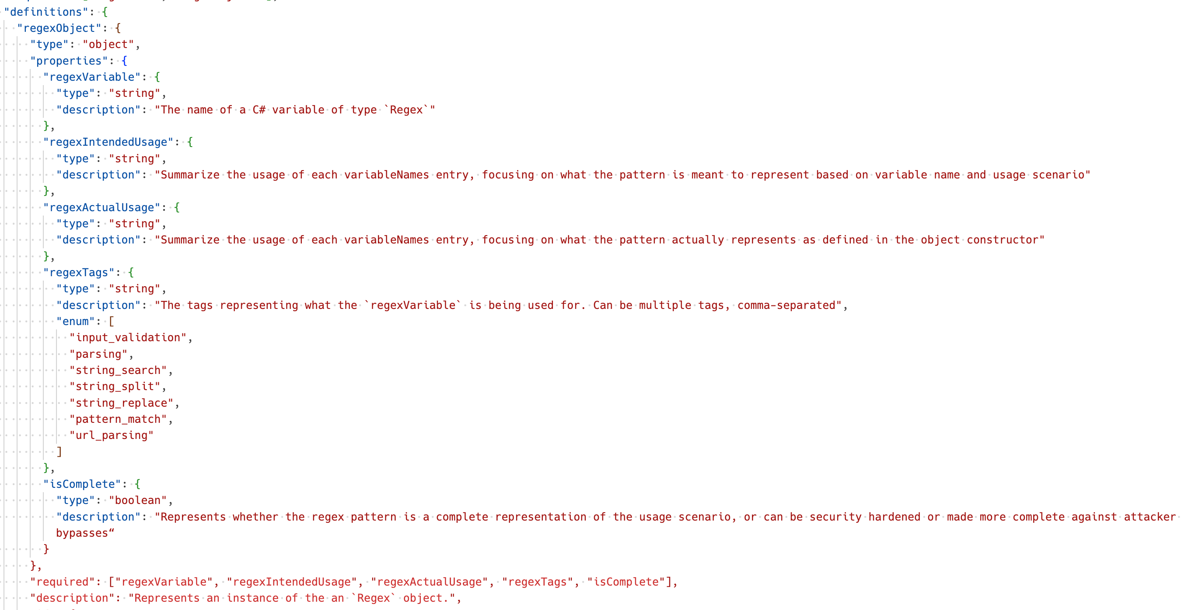
Putting it together
Prompt
Better

Slide 58
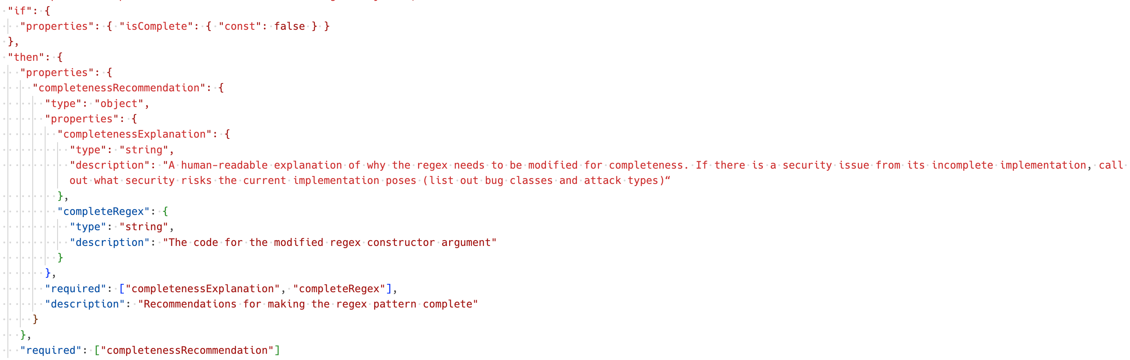
Putting it together
Prompt
Even better (conditional sub-schemas)

Slide 59
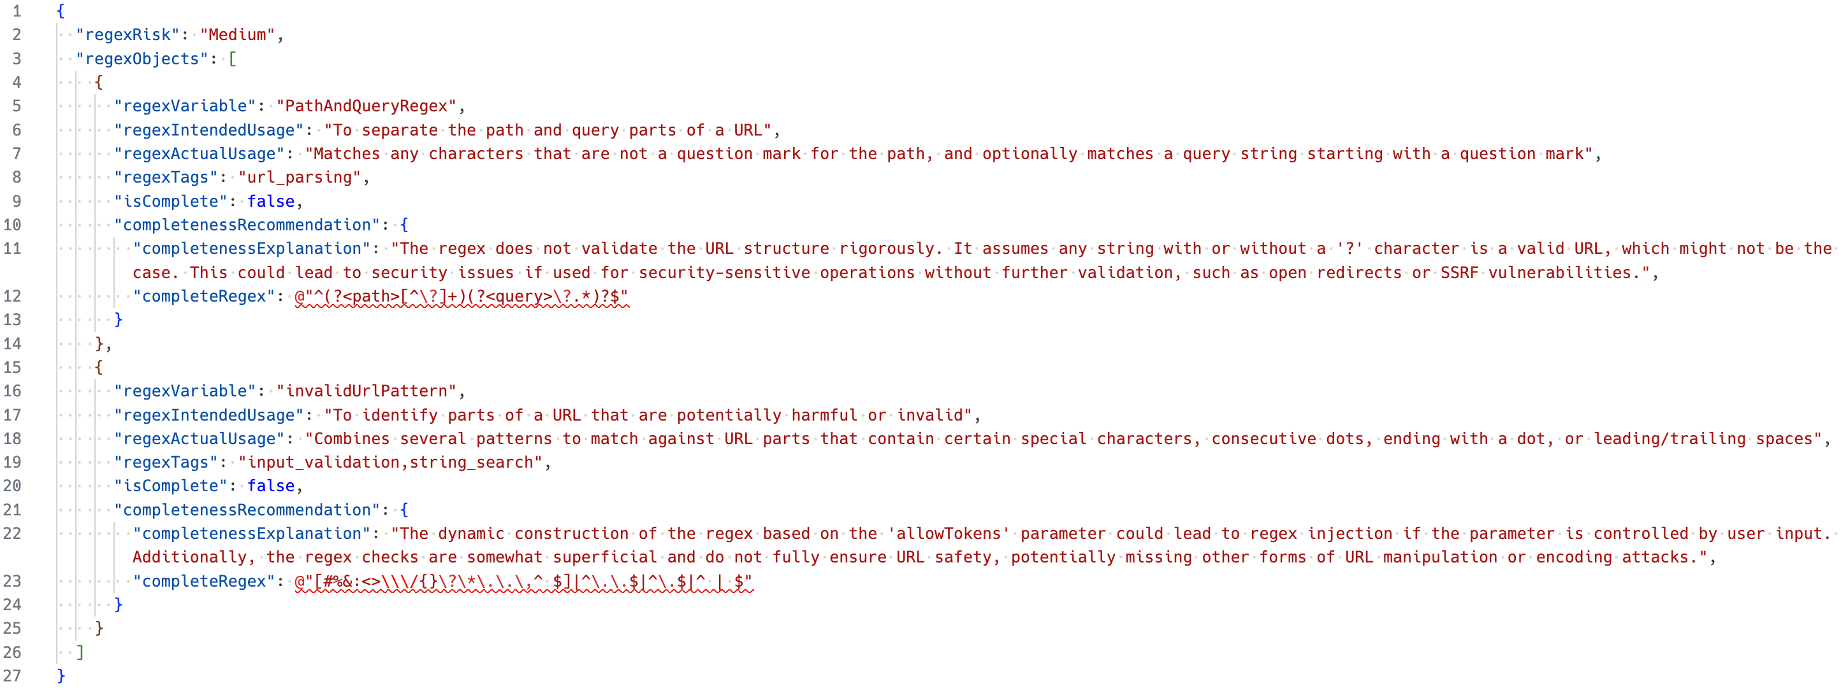
Putting it together
Response

Slide 60
Initial Results
Prioritized Triage
Riskiest <5%
True Positives
>90%
False Negatives
Harder to determine

Slide 61
Practical Exercises with Semgrep
MODULE 5

Slide 62
Practical Exercises with Semgrep
C#, TypeScript, Python
https://aka.ms/semgrep-workshop

Slide 63
Wrap-up

Slide 64
Wrap-up
Recap of key takeaways from the workshop
Learning resources and contributing to community

Slide 65
References
Academy Courses
Semgrep 101
Secure Coding
Semgrep Custom Rules Level 1
Semgrep Documentation
Quickstart
Local scans with Semgrep
Writing rules
Custom rule examples

Slide 66
Q&A

